Slide 1

DevOps
DevOps is the combination of cultural philosophies, practices, and tools that increases an organization’s ability to deliver applications and services at high velocity
DevOps Learning Road Map

Slide 2


Amazon Web Services
GSG DevOps Bootcamp

Slide 3
Introduction to Cloud.
AWS global Infrastructure
IAM
AWS Billing
EC2.
S3.
EBS.
Route 53
Content
1

Slide 4



How do we reach a Website
Client
Network
Server

Slide 5
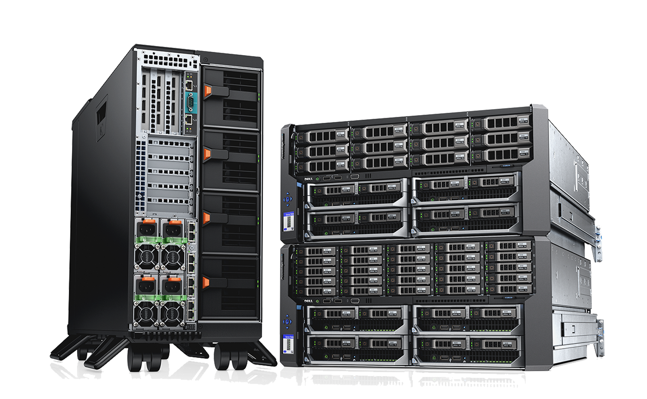
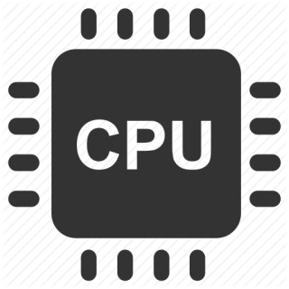
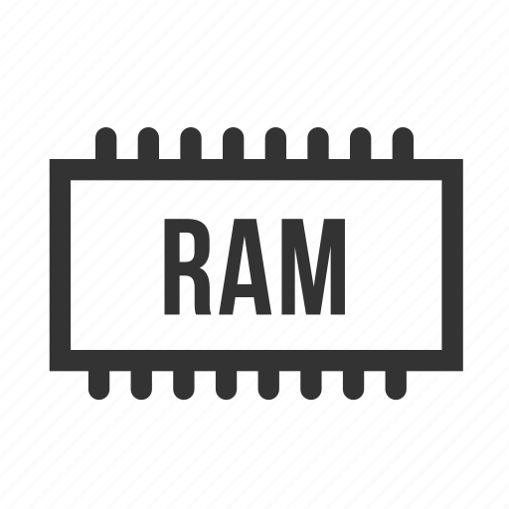

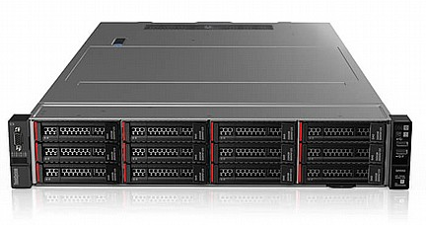
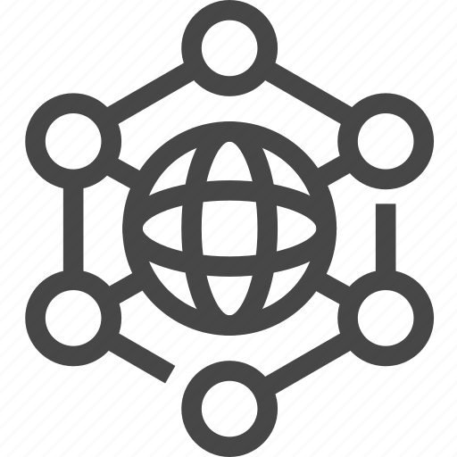
What is a server?
CPU.
Memory.
Storage.
Network.

Slide 6
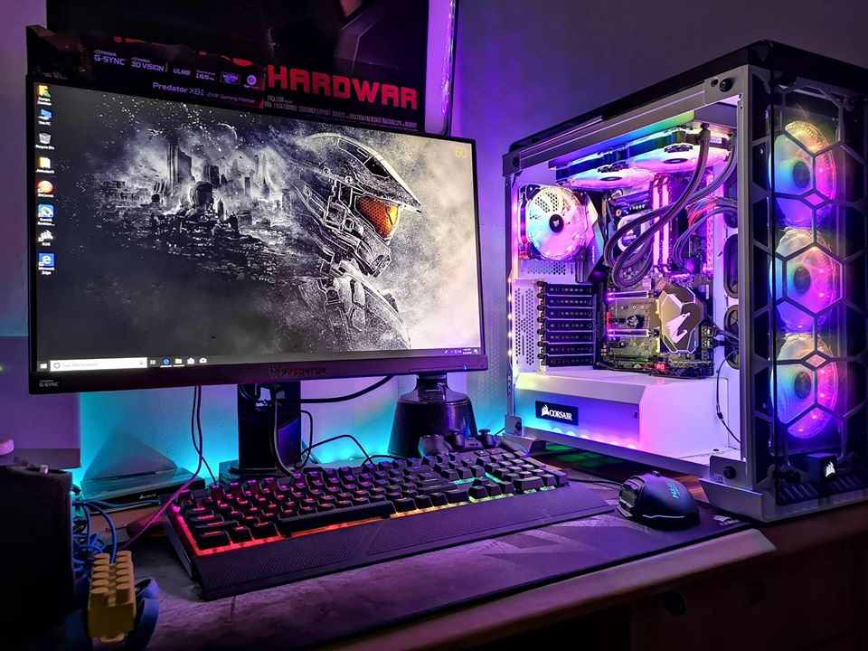
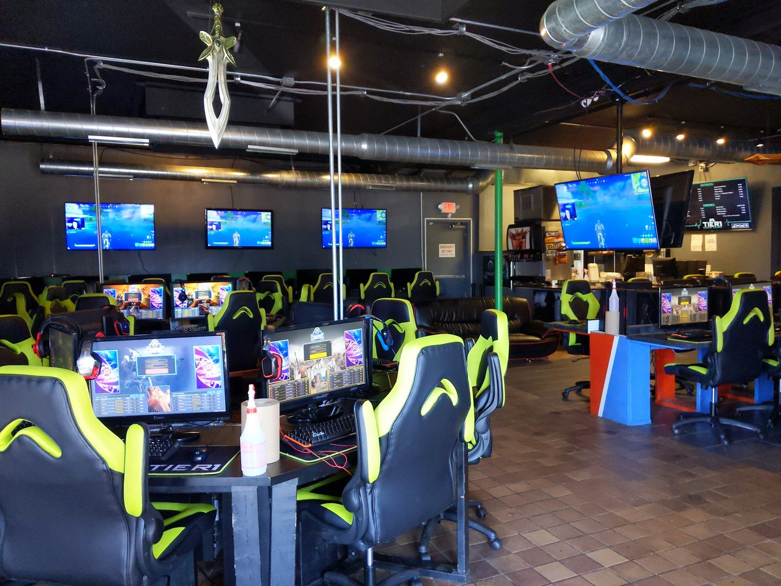
Gaming Center Use Case
VS

Slide 7


Cloud Computing
Cloud computing is the on-demand delivery of IT resources over the Internet with pay-as-you-go pricing. Instead of buying, owning, and maintaining physical data centers and servers, you can access technology services, such as computing power, storage, and databases, on an as-needed basis from a cloud provider

Slide 8
Cloud Models
Private Cloud:
Cloud services used by a single organization, not exposed to the public.
Public Cloud:
Cloud resources owned and operated by a third- party cloud service provider delivered over the Internet.
Hybrid Cloud:
Keep some servers on premises and extend some capabilities to the Cloud

Slide 9
Advantages of Cloud Computing
Flexibility
Cost-Effectiveness
Scalability
Elasticity
High-availability and fault-tolerance
Agility

Slide 10
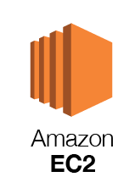


Types of Cloud Computing:
Infrastructure as a Service (IaaS)
Platform as a Service (PaaS)
Software as a Service (SaaS)

Slide 11
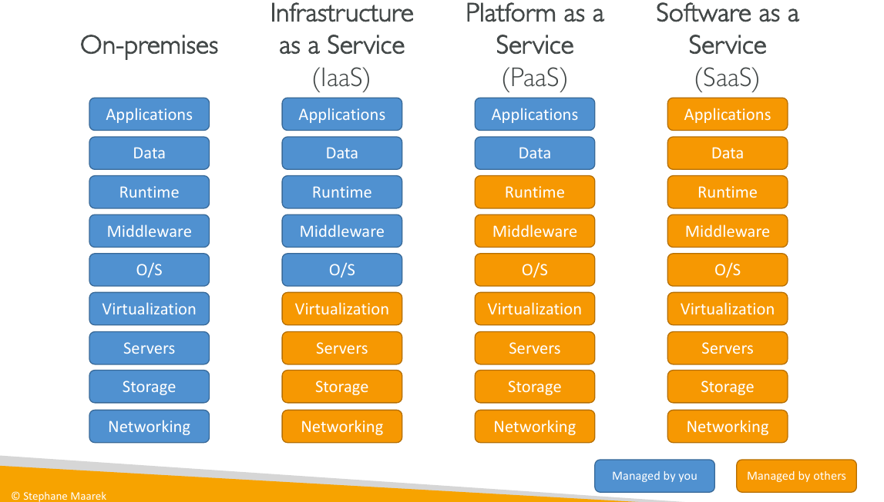

Slide 12
Pricing of the cloud:
Compute: Pay for the compute time.
Storage: Pay for data stored in the cloud.
Data transfer: Data transfer in & out

Slide 13
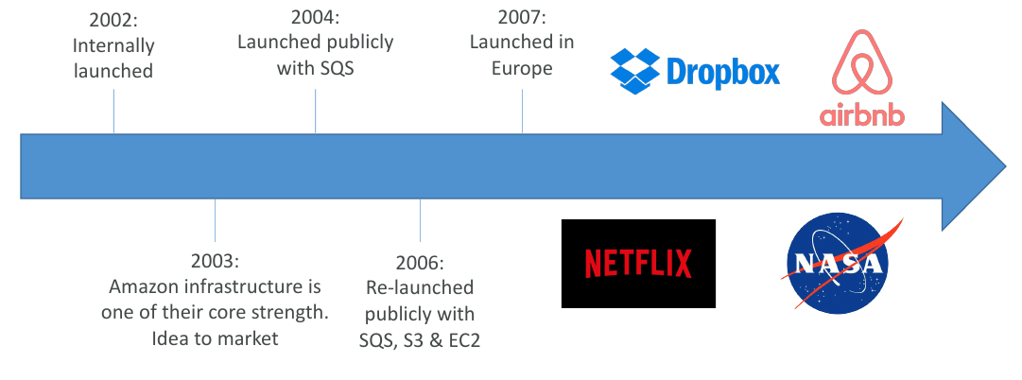
AWS Cloud History

Slide 14
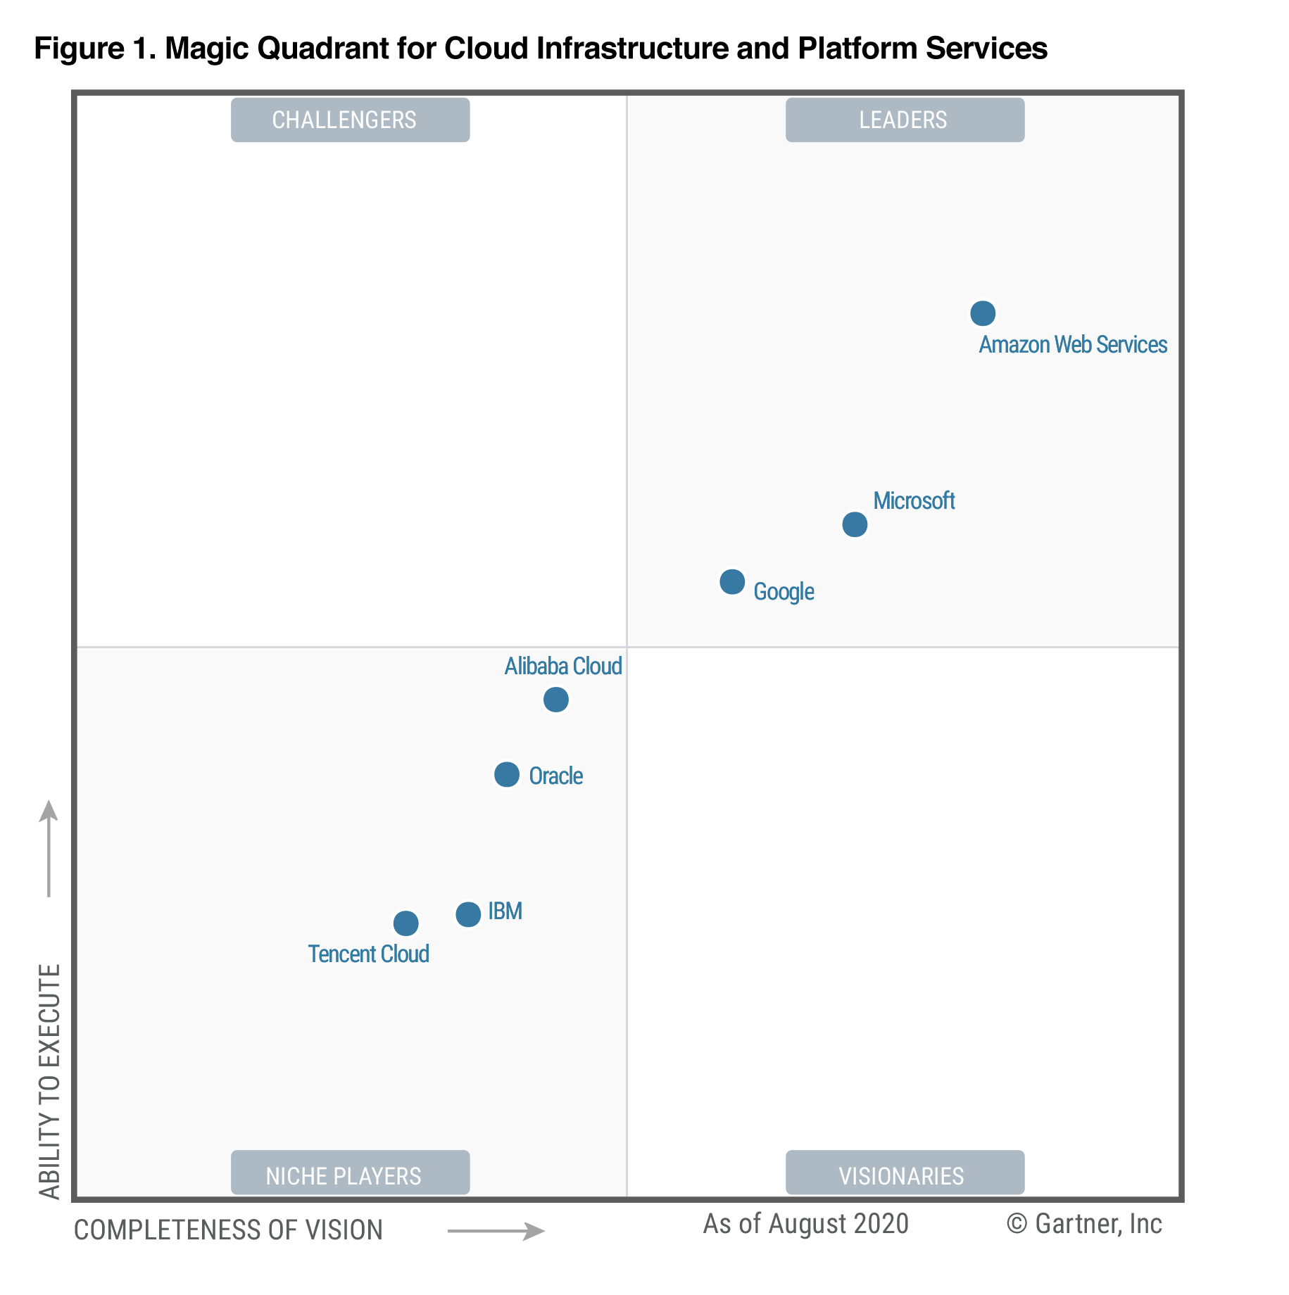
AWS Cloud Numbers
In 2019, AWS had $35.02 billion in annual revenue
AWS accounts for 47% of the market in 2019 (Microsoft is 2nd with 22%).
Pioneer and Leader of the AWS Cloud Market for the 9th consecutive year
Over 1,000,000 active users.

Slide 15
AWS Cloud Use Cases
AWS enables you to build sophisticated, scalable applications.
Enterprise IT, Backup & Storage, Big Data analytics.
Website hosting, Mobile & Social Apps
Gaming

Slide 16
AWS Global Infrastructure
Click Here to access Slides.

Slide 17
AWS Elastic Cloud Compute (EC2)
Click Here to access Slides.

Slide 18
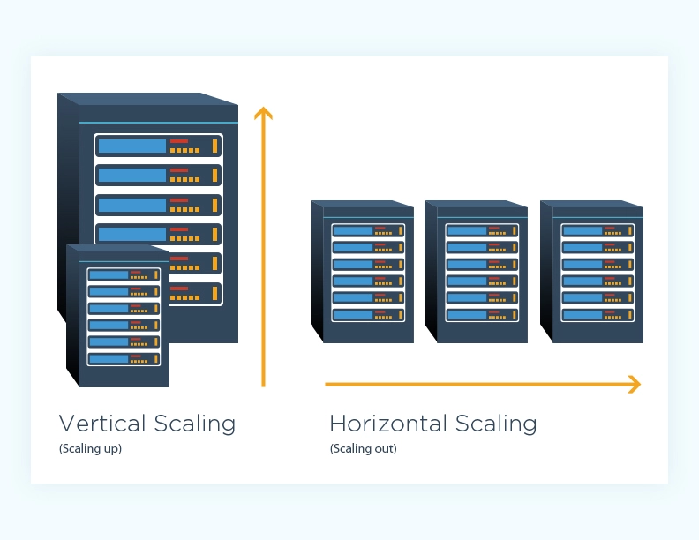
Vertical scaling VS Horizontal scaling

Slide 19
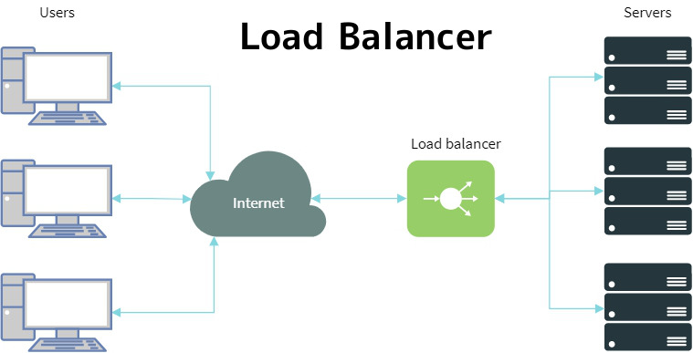
Load Balancing

Slide 20
What is a port
A port is a virtual point where network connections start and end. Ports are software-based and managed by a computer's operating system. Each port is associated with a specific process or service.
Classic Ports to know:
22 = SSH (Secure Shell) - log into a Linux instance
80 = HTTP – access unsecured websites
443 = HTTPS – access secured websites

Slide 21
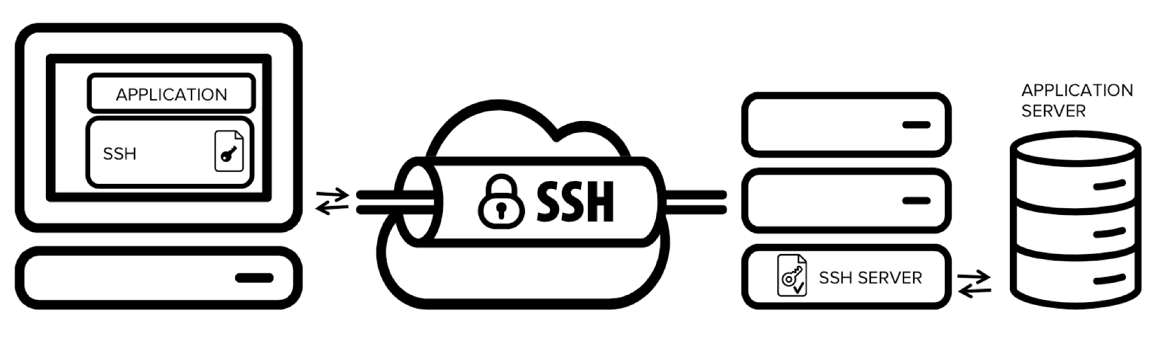
SSH (PORT 22)
SSH, also known as Secure Shell or Secure Socket Shell, is a network protocol that gives users, particularly system administrators, a secure way to access a computer over an unsecured network.

Slide 22
AWS Security Groups
Click Here to access Slides.

Slide 23
App Script
apt update -y && apt install -y apache2
systemctl start apache2
echo "<h1>Hello World from $(hostname -f)</h1>" > /var/www/html/index.html

Slide 24
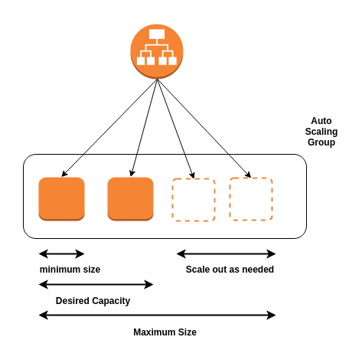
Auto Scaling Group
Click Here to access Slides.

Slide 25

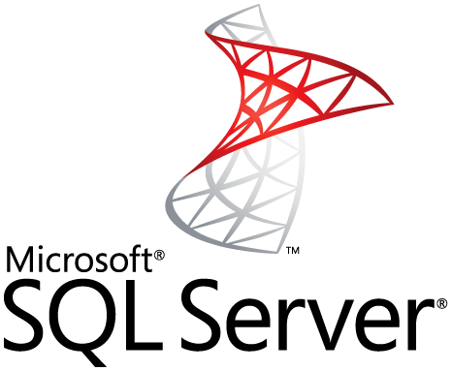


AWS RDS
RDS: Amazon Relational Database Service (Amazon RDS) makes it easy to set up, operate, and scale a relational database in the cloud.

Slide 26

AWS IAM
Click Here to access Slides.

Slide 27

AWS Billing & Budgets
Click Here to access Slides.

Slide 28
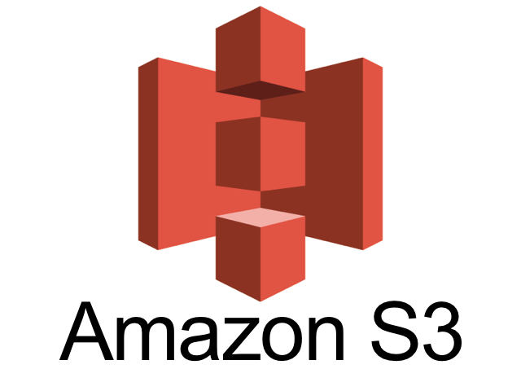
AWS S3
Click Here to access Slides.

Slide 29
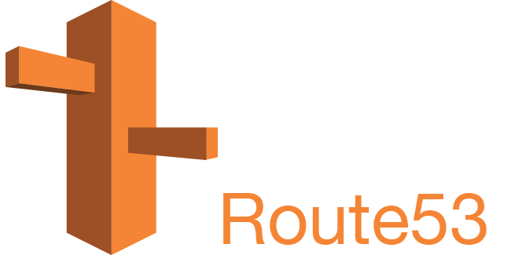
AWS Route 53
Click Here to access Slides.

